Slide 1
Applied Point Pattern Analysis
Antonio Páez
School of Geography and Earth Sciences
McMaster University

Slide 2
Theory: Spatial pricing
Market areas
Type of pattern
Developing testable hypotheses

Slide 3
Point pattern analysis
Identifying patterns
Nearest neighbor analysis
Exploratory technique
Point-event nearest neighbor (F-hat)
Event-event nearest neighbor (G-hat)
Moving windows

Slide 4
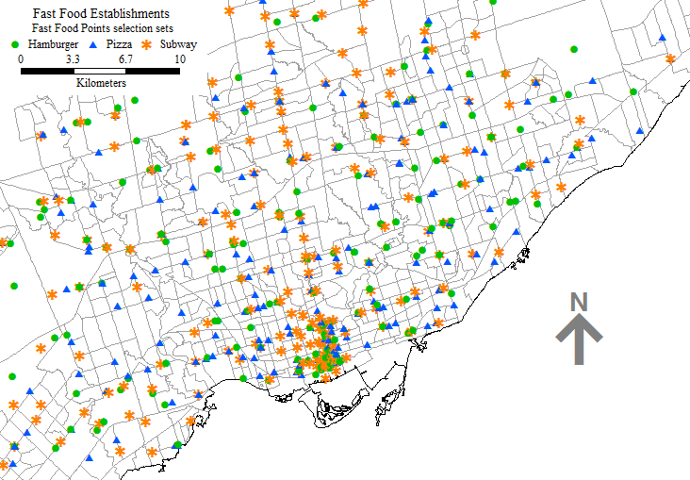
Example: fast food in Toronto

Slide 5
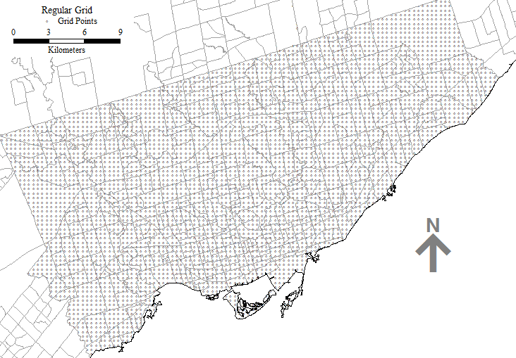
Fast food in Toronto

Slide 6
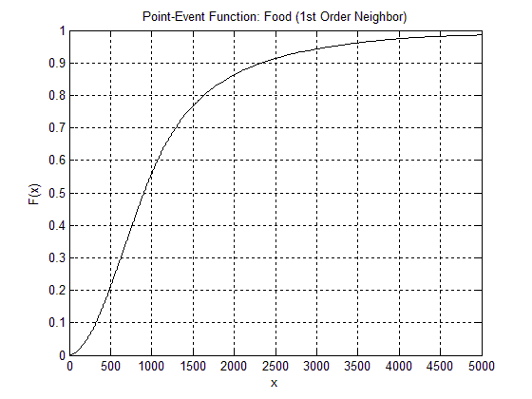
Fast food in Toronto (F)

Slide 7
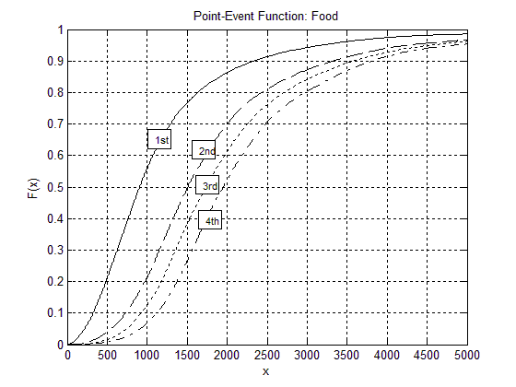
Fast food in Toronto (F)

Slide 8
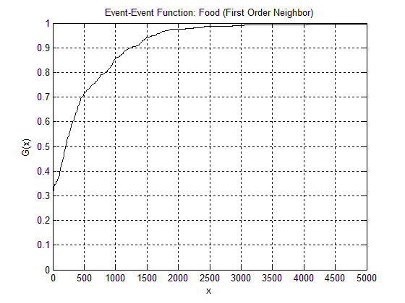
Fast food in Toronto (G)

Slide 9
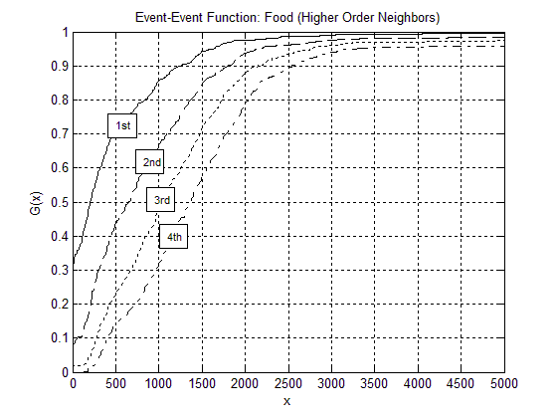
Fast food in Toronto (G)

Slide 10
Fast Food in Toronto
Pattern?
Relationship to theory?
Discussion

Slide 11
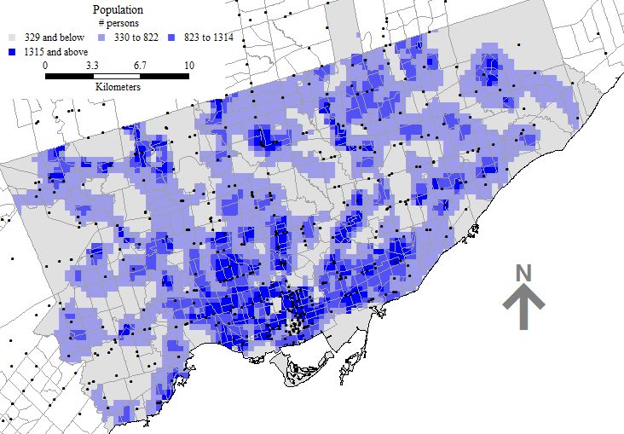
Distribution of Population

Slide 12
Weighted F function
“Points” now have an attribute of interest

Slide 13
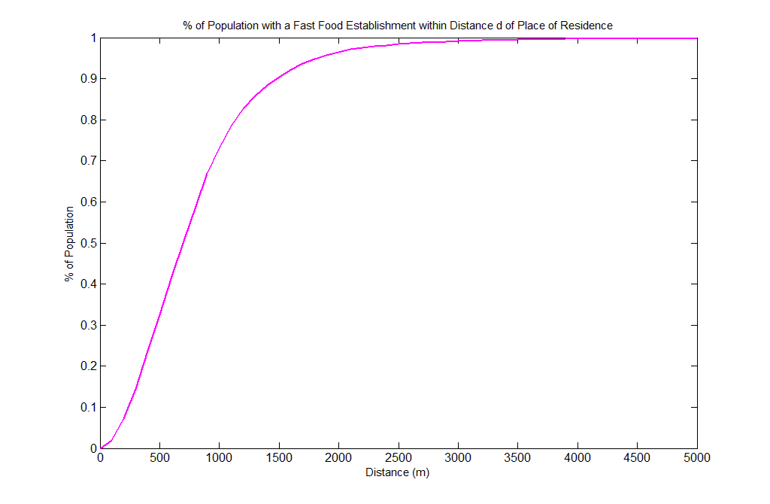
Weighted F function (Population)

Slide 14
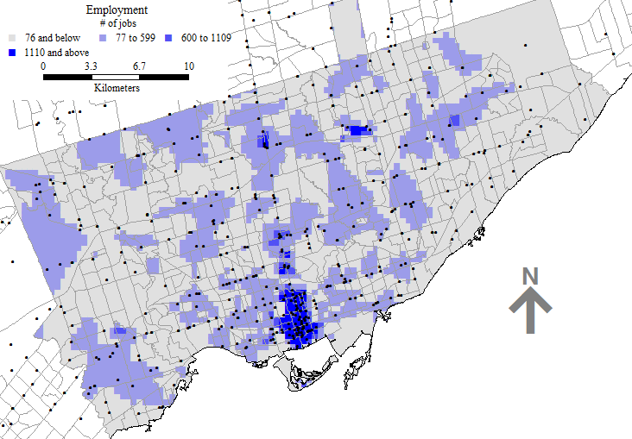
Distribution of Employment

Slide 15
Weighted F function (Employment)

Slide 16
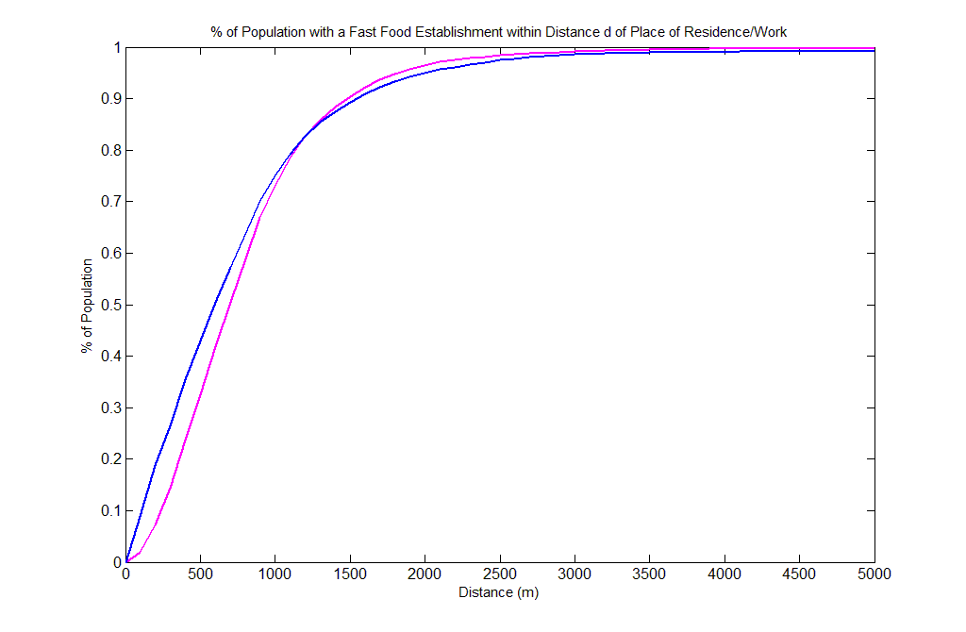
Weighted F function (Pop/Emp)
Kolmogorov-Smirnov 2-sample distribution test
H₀: X1 and X2 have same continuous distribution (reject)

Slide 17
Measuring Spatial Concentration
Moving windows

Slide 18
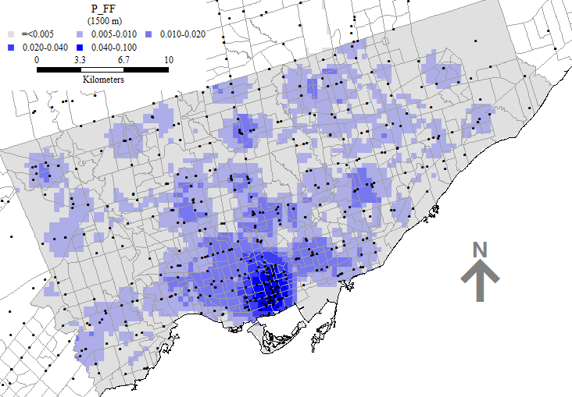
Fast food – 1500 m concentration

Slide 19
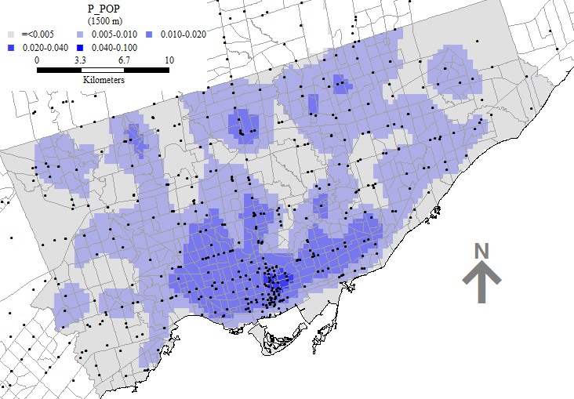
Population – 1500 m concentration

Slide 20
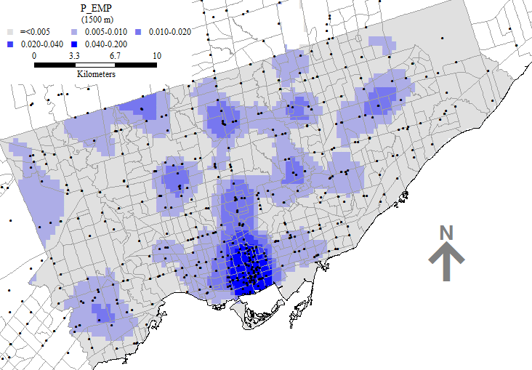
Employment – 1500 m concentration

Slide 21
Moving windows ratio of proportions
Are two levels of concentration proportional?

Slide 22
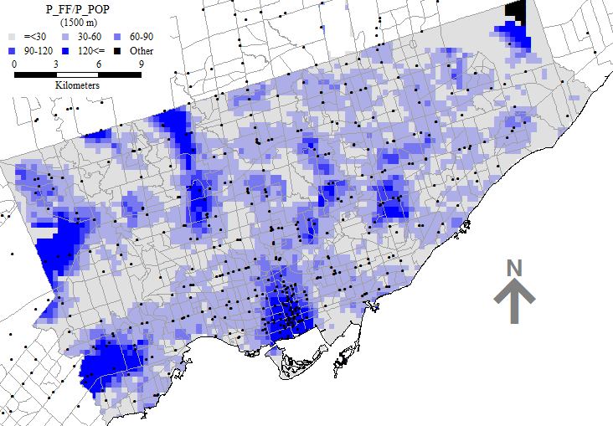
Ratio of proportions – Food/Pop

Slide 23
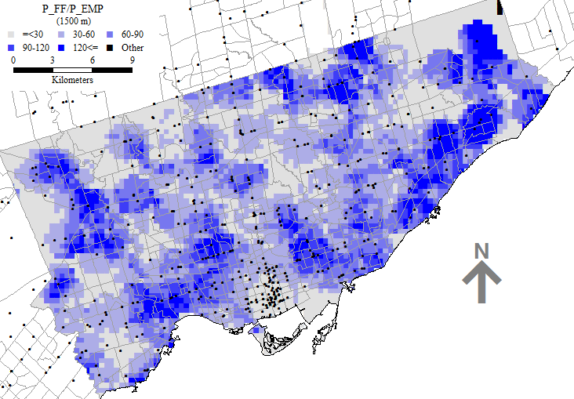
Ratio of proportions – Food/Emp

Slide 24
Summary + Discussion
Spatial pricing theory: Market area patterns
Testable hypotheses
Point pattern analysis techniques
Nearest neighbor analysis
Moving windows
What does the evidence indicate?
What is the theory good for?

